Slide 1
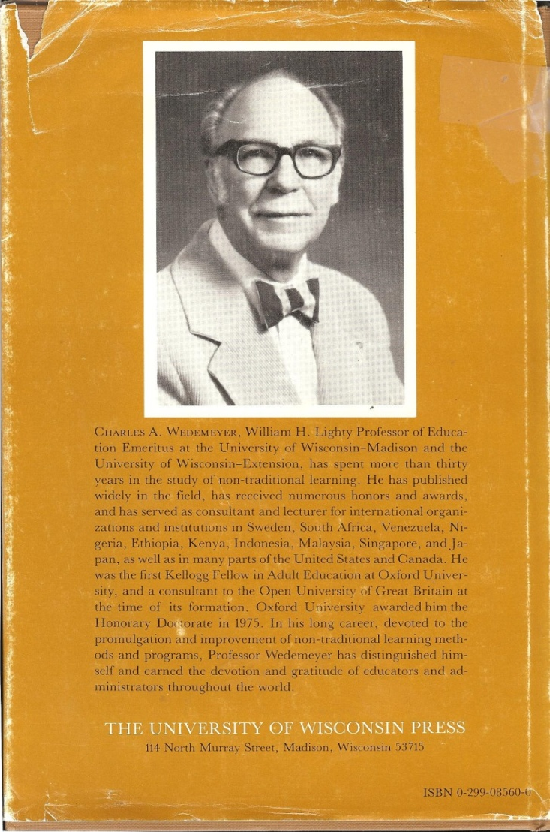
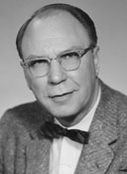
My Confession: Correspondence & TV Courses changed my life…
(Thanks to Bob Clasen and Charles Wedemeyer, the University of Wisconsin)

Slide 2
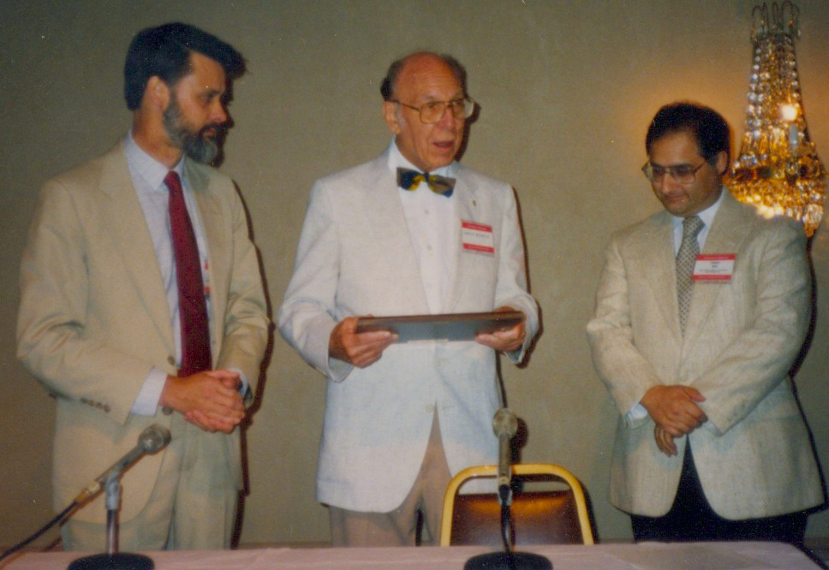
Michael G. Moore, Charles A. Wedemeyer, and Fred Saba (the First Wedemeyer award recipient)

Slide 3
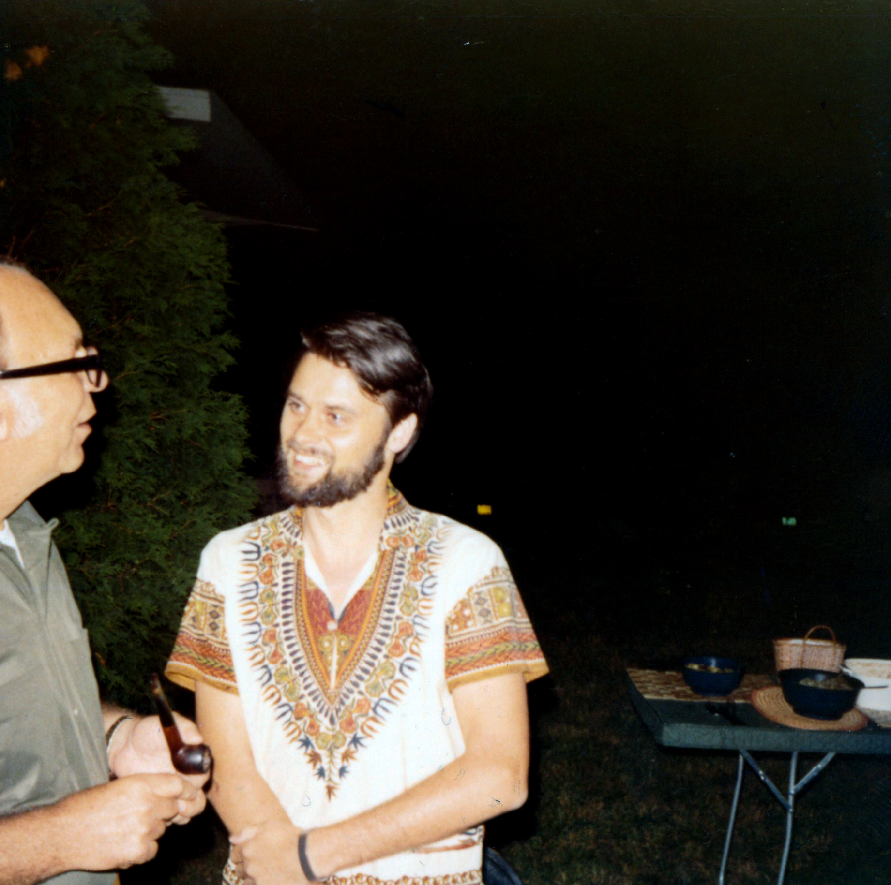
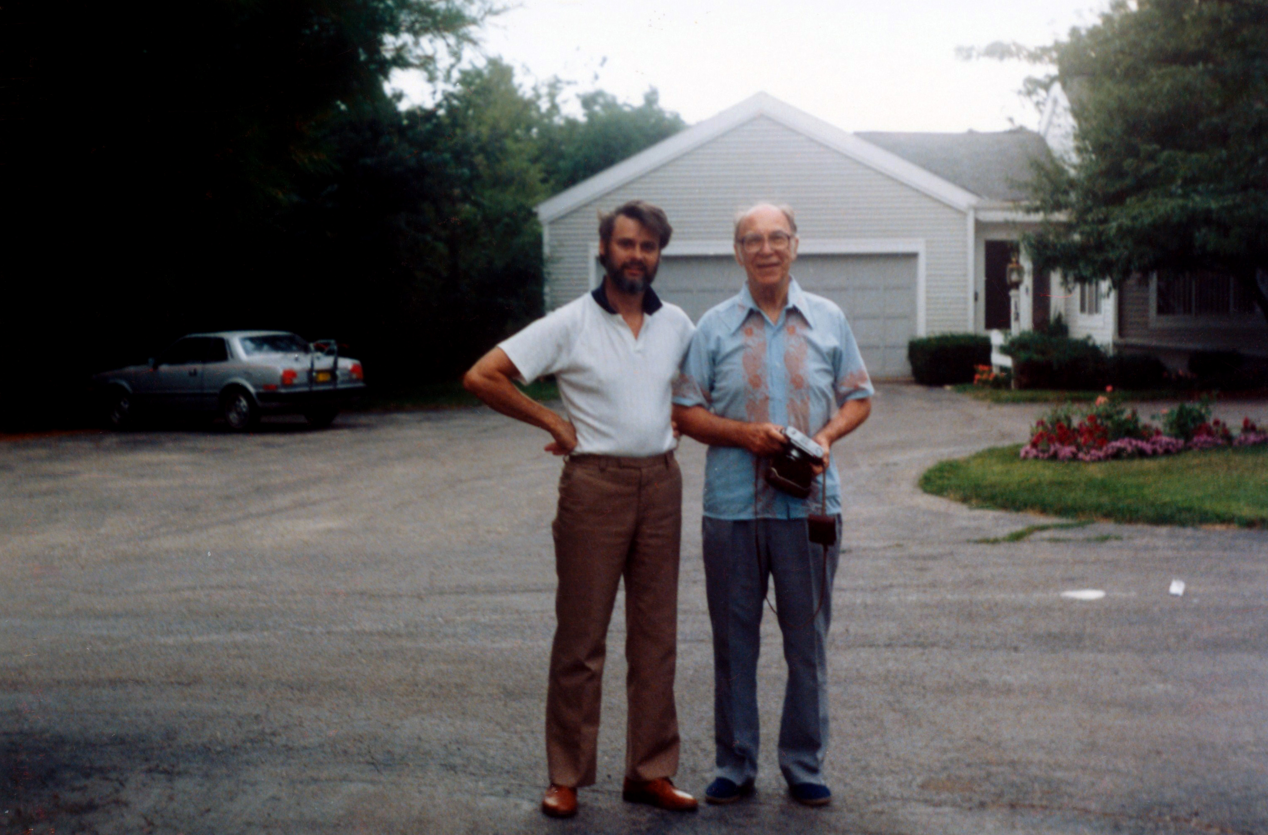
Charles A. Wedemeyer and Michael G. Moore

Slide 4
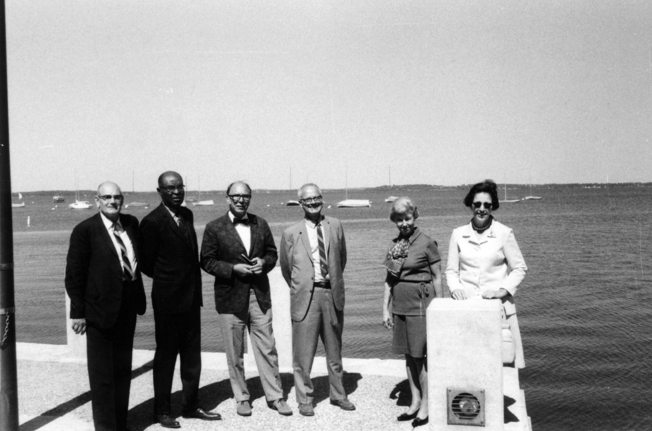
Wedemeyer's "kitchen cabinet" when he was President of ICDE (International Council for Open and Distance Education; was called ICCE then); photo taken by Michael Moore outside Lowell Hall

Slide 5
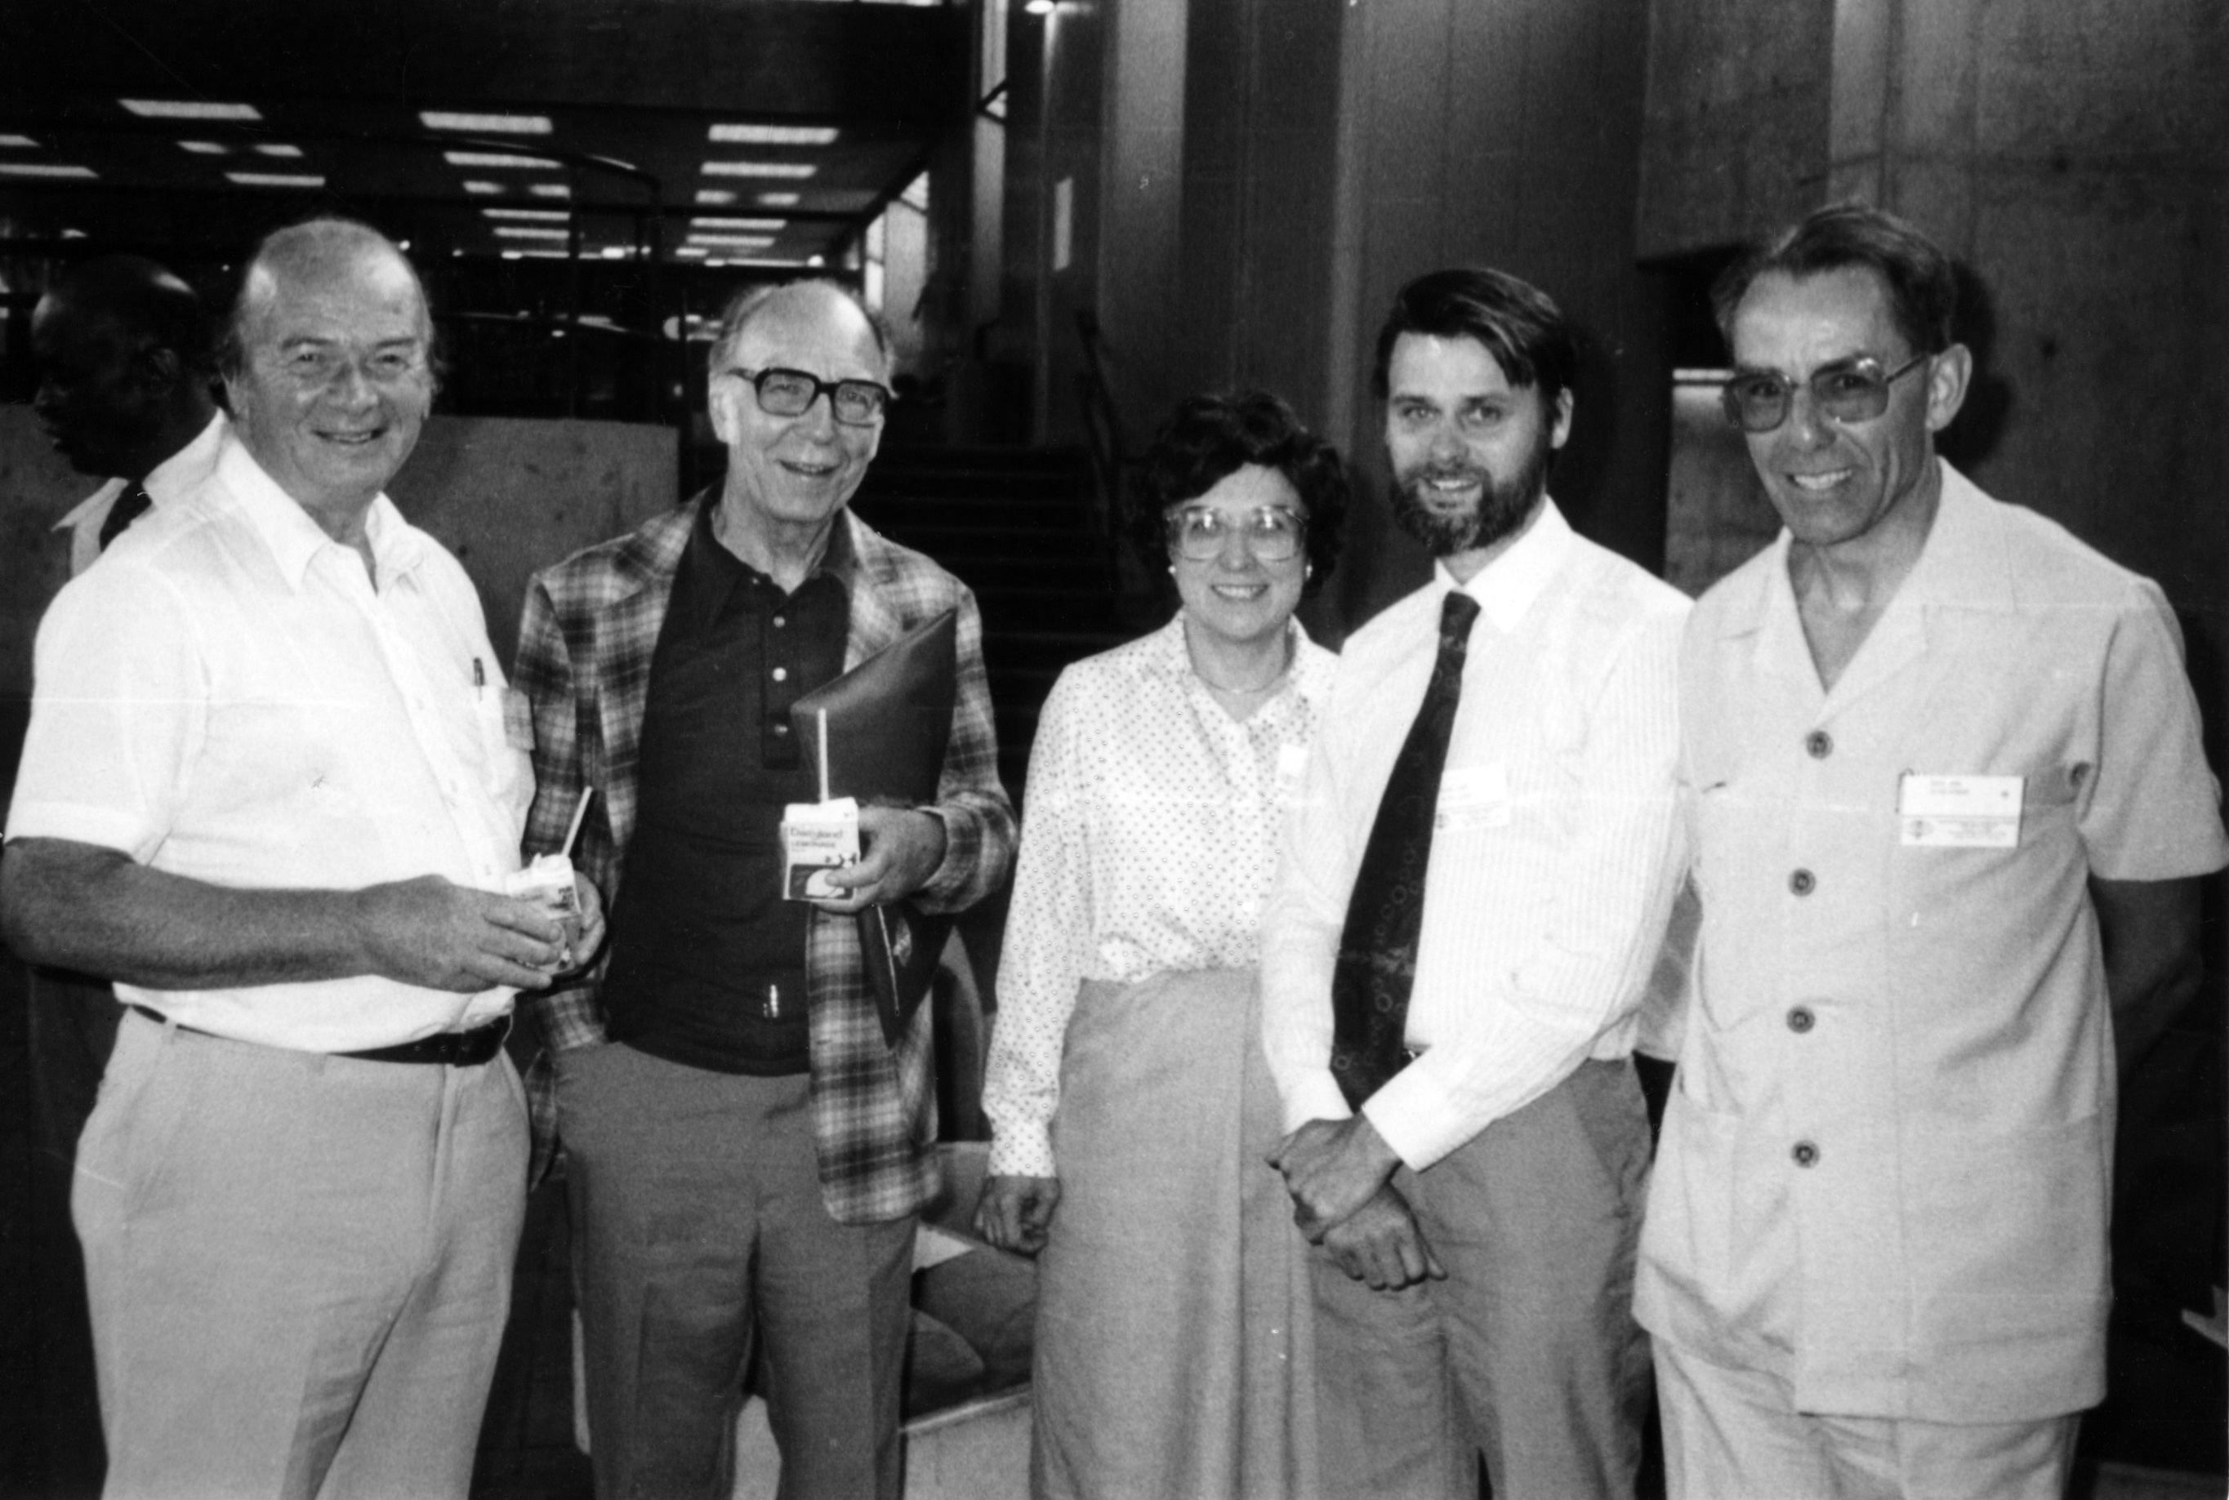
Walter Perry (the first vice chancellor of UK Open University), Charles A. Wedemeyer, Dorothy (?) Campbell, Michael G. Moore, and David Young

Slide 6
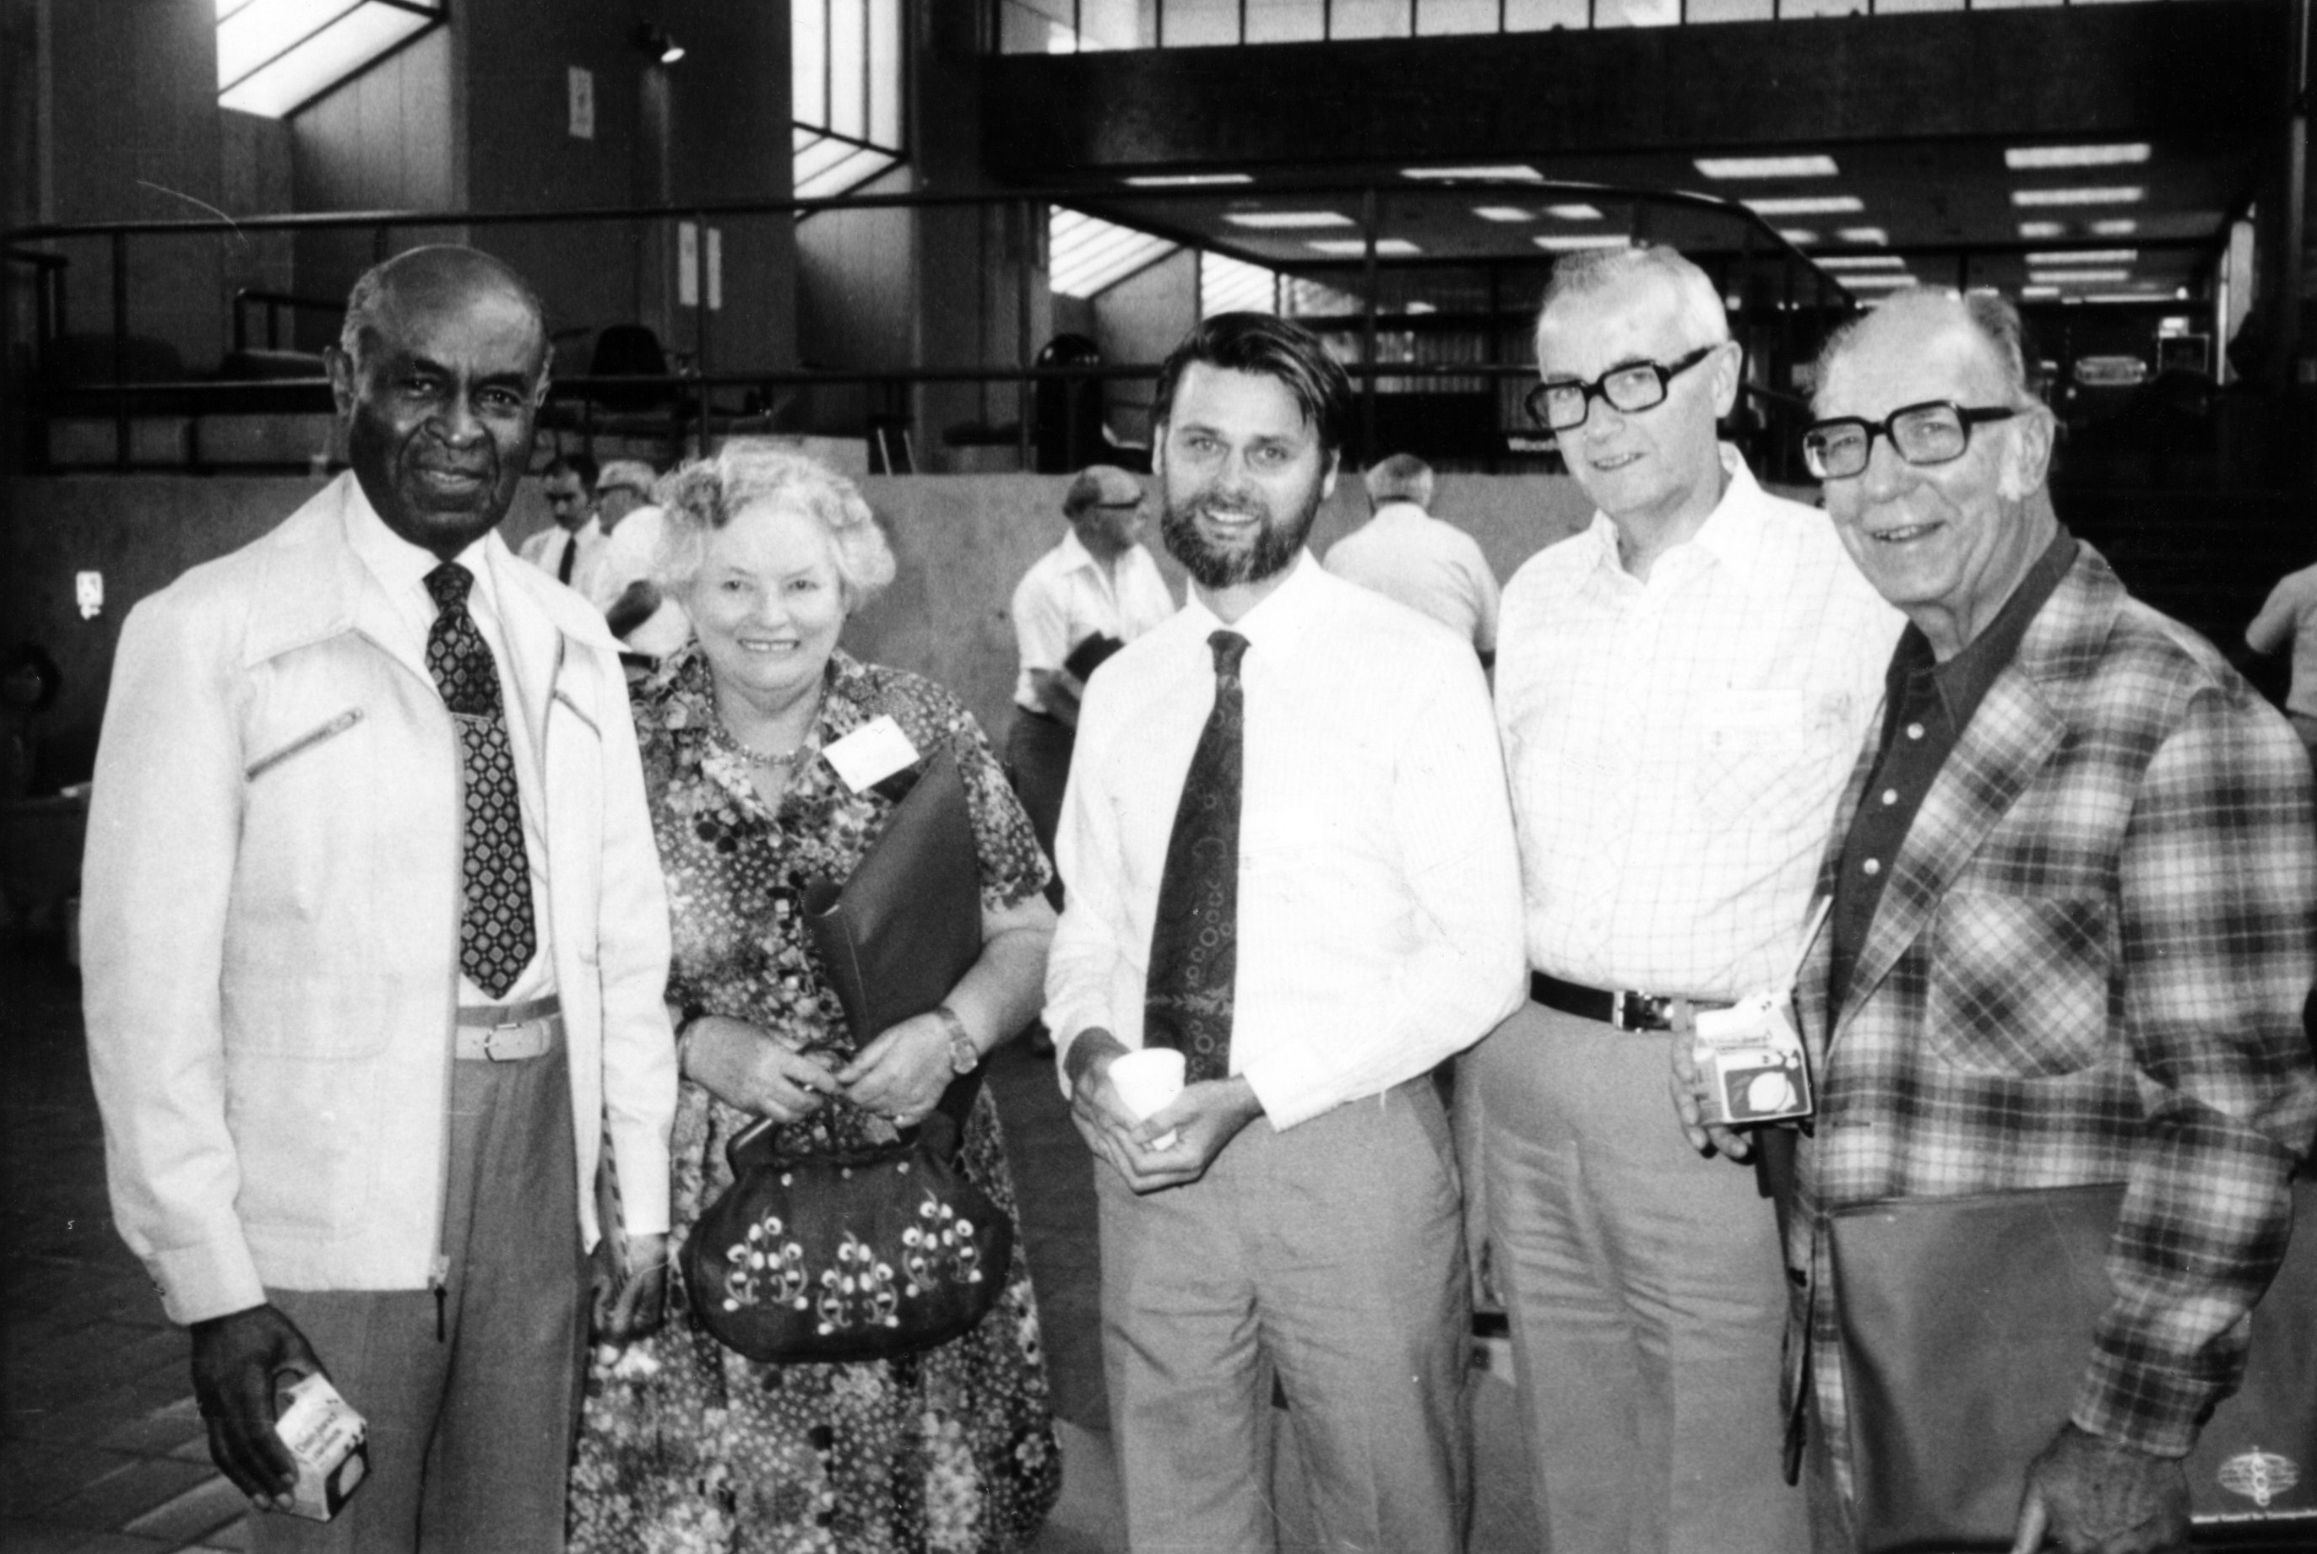
Ripley Sims, Rene Erdos (past president of ICCE), Michael G. Moore, Borje Holmberg, and Charles A. Wedemeyer

Slide 7
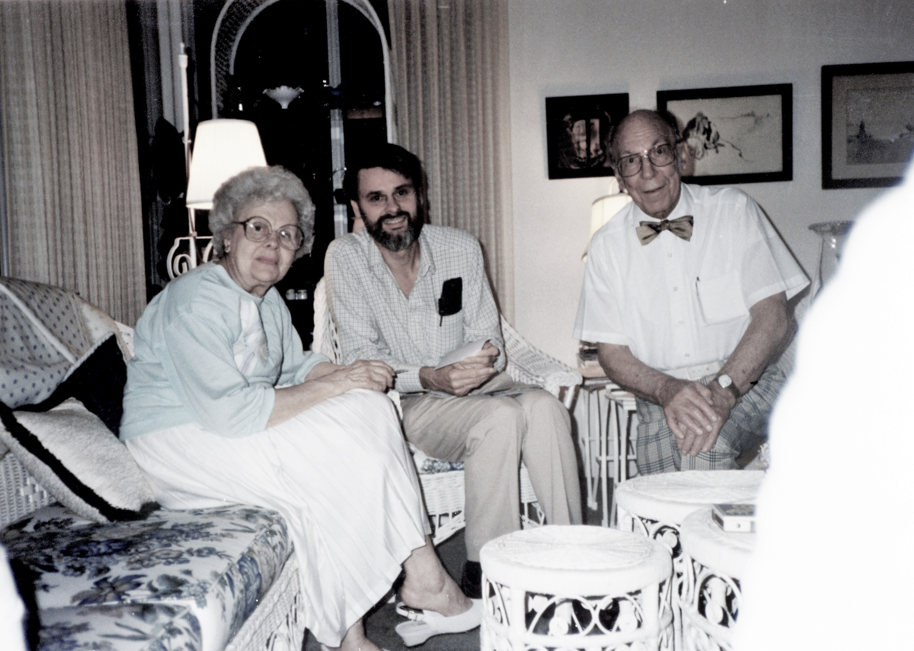
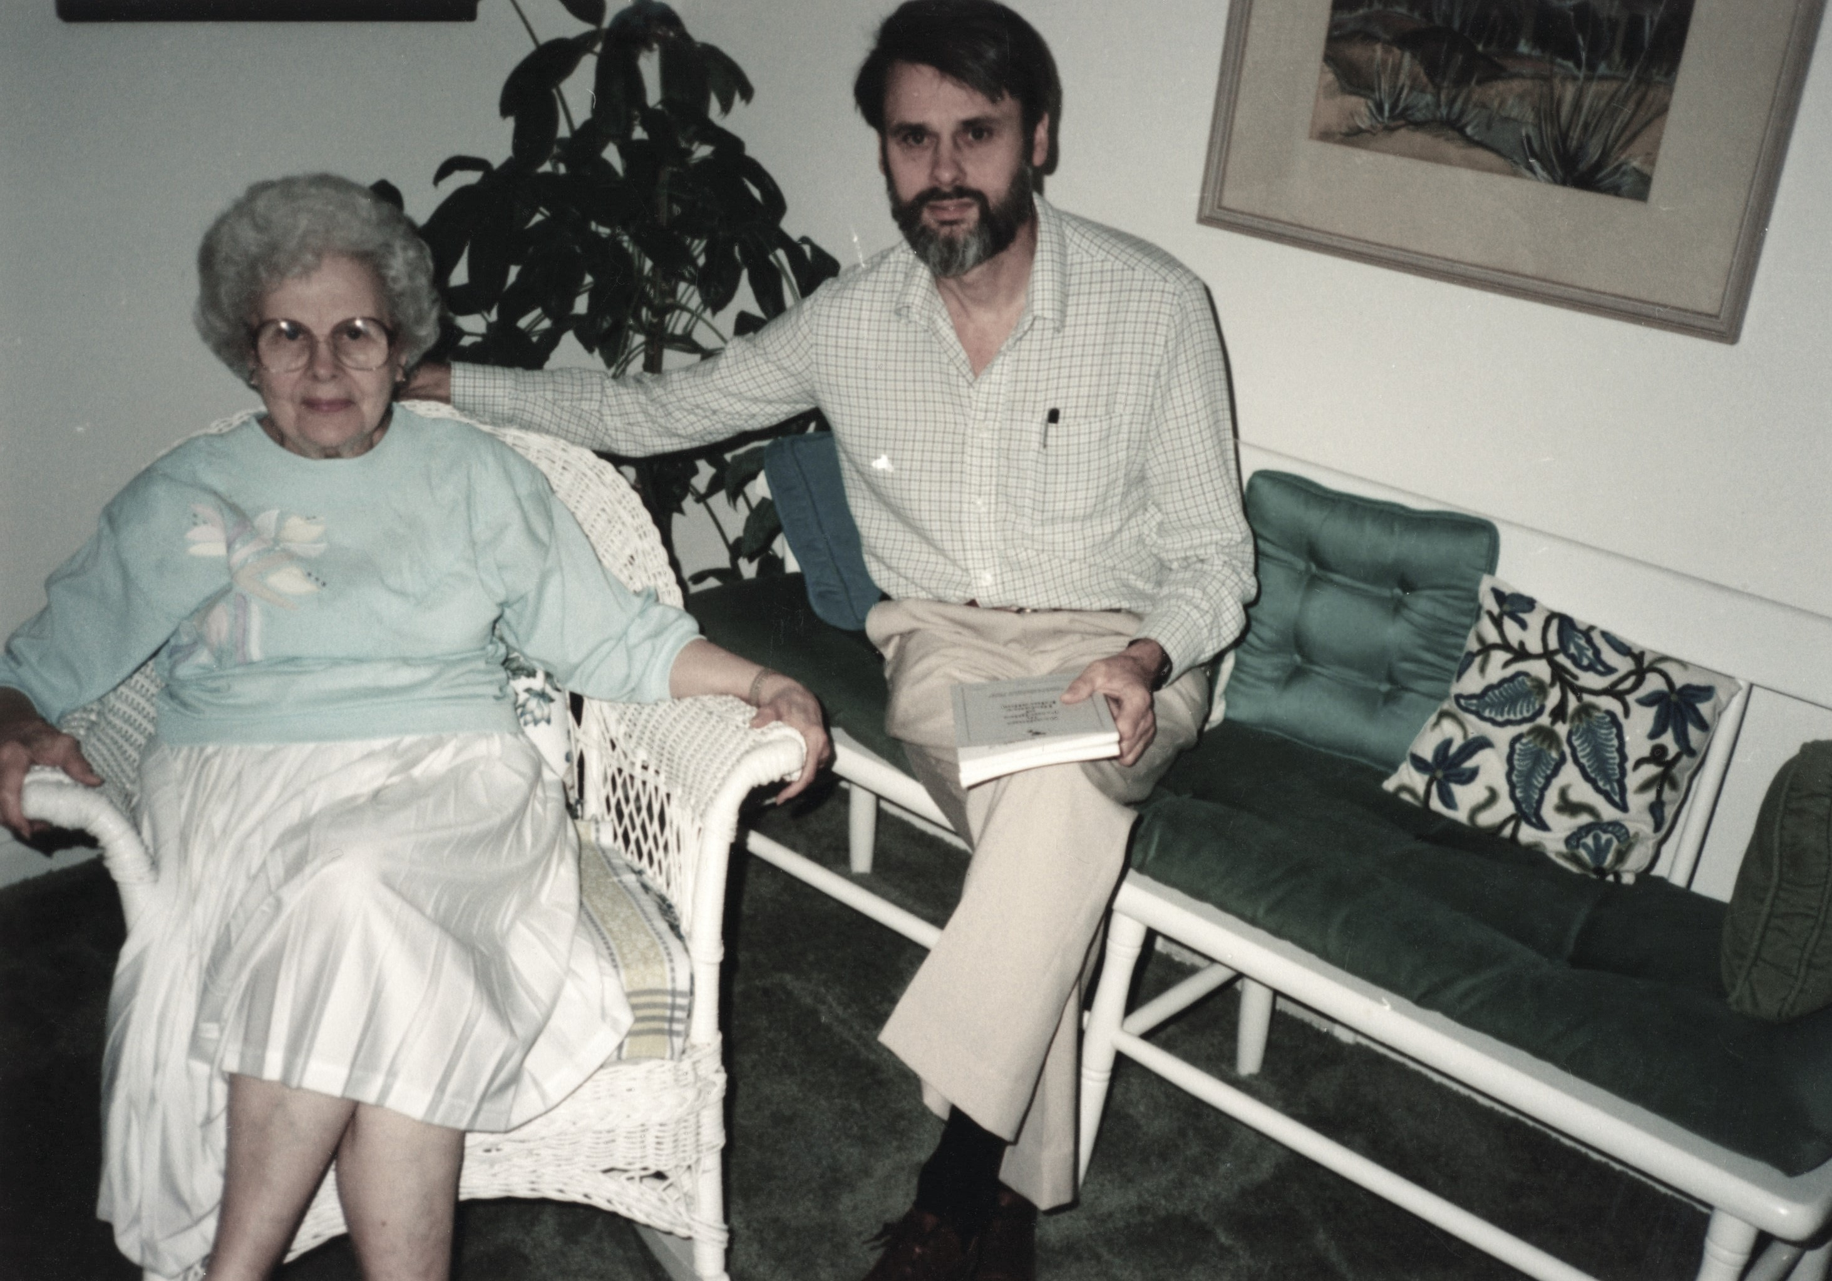
Mildred Wedemeyer, Michael G. Moore, and Charles A. Wedemeyer

Slide 8
Charles Wedemeyer Quote #1: “It should be immaterial whether one has learned at the front door or the back door of the Palace of Learning. What one has learned—not where, or how, in what sequence, at what institution, or in what period of time—is the only criterion of supreme importance.” (Charles Wedemeyer, 1981, p. 216)

Slide 9
Charles Wedemeyer Quote #2: ”If America is on the threshold of becoming a Learning Society, non-traditional learning may be its most genuine ingredient.” (Charles Wedemeyer, 1981, p. 219)

Slide 10
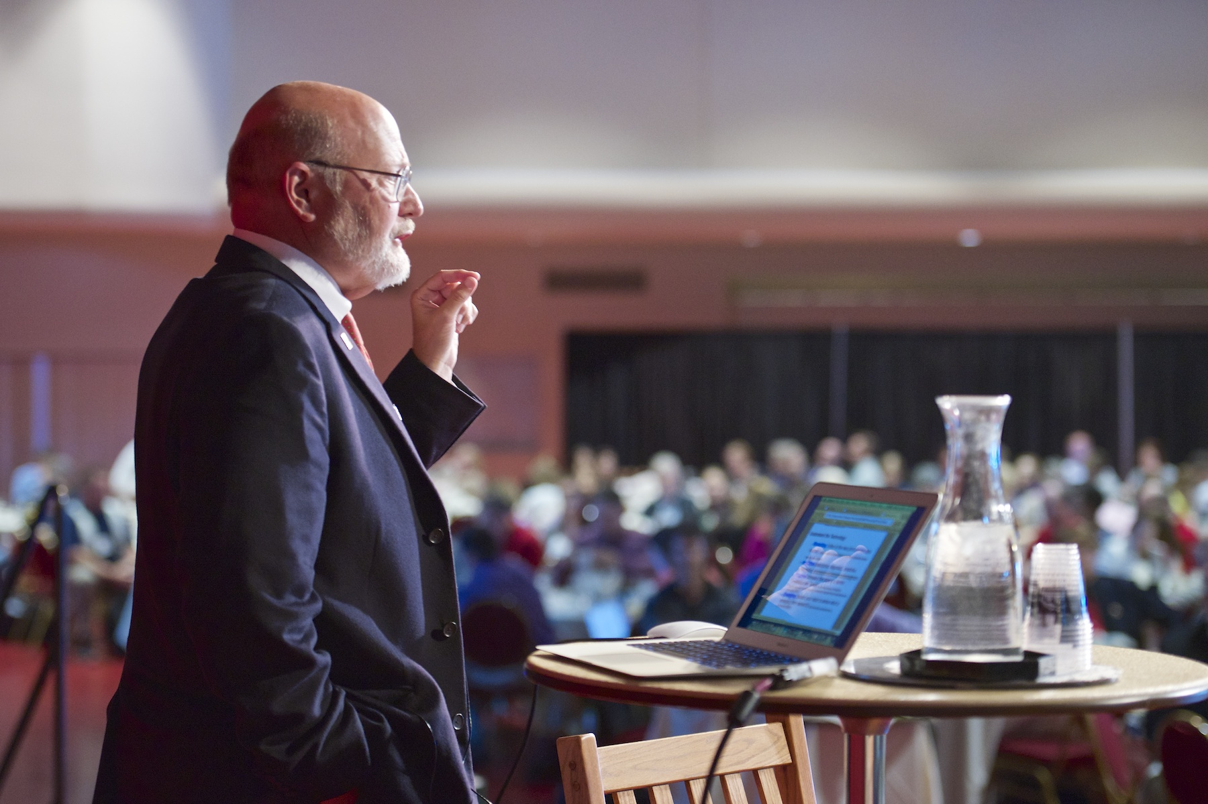
Ray Schroeder Professor Emeritus of Communication Founding Director of the Center for Online Learning, Research and Service (COLRS) Associate Vice Chancellor for Online Learning, The University of Illinois at Springfield

Slide 11
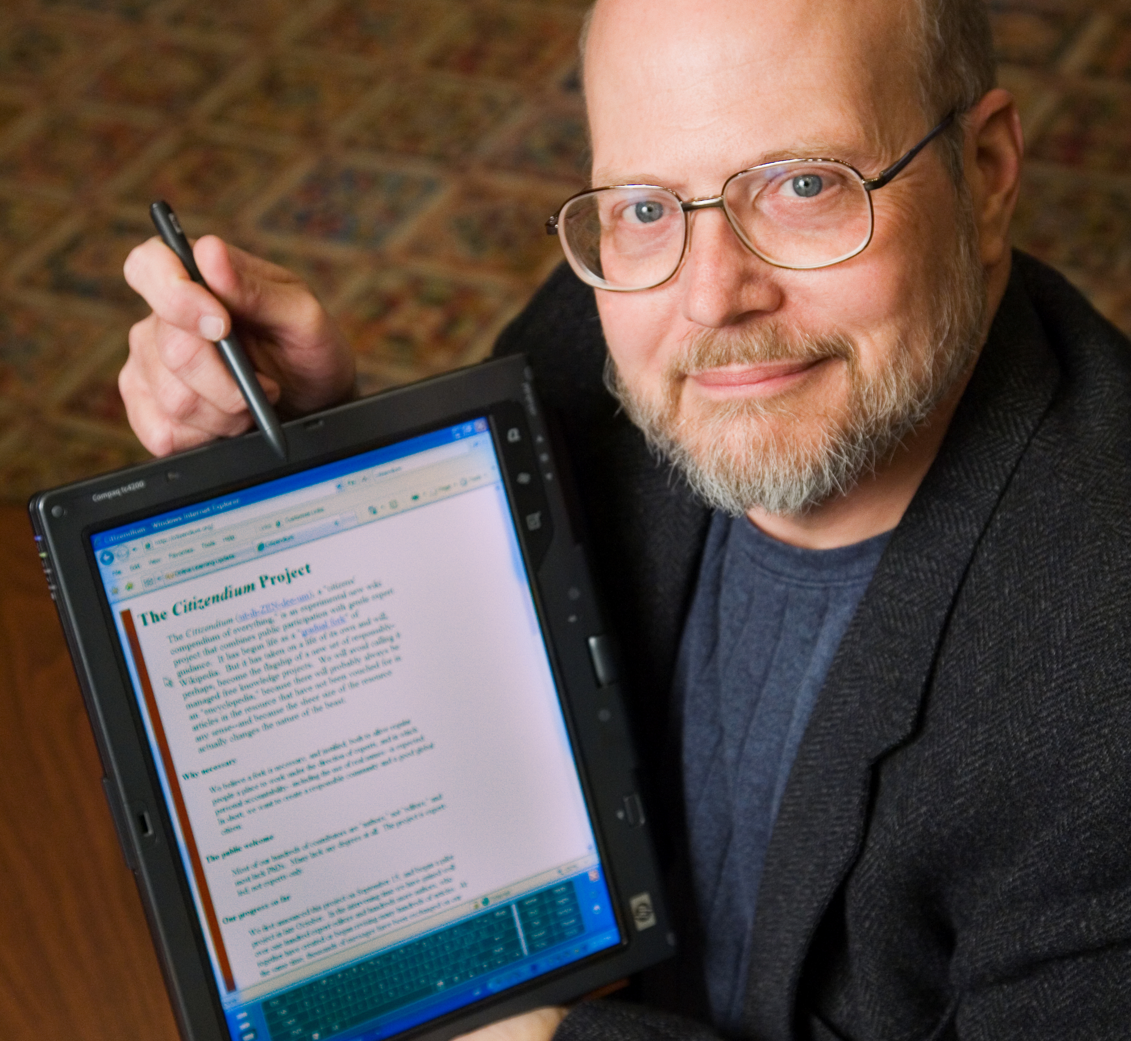
Ray Schroeder: The Blogger Extraordinaire
5 Blogs 365 Days per year
Posts 3 items/day per blog
30,000 blog visits a month
62,469 total blog posts as of July 30, 2016
7,570 Twitter impressions/day from 5 Twitter accounts
2,750 enrolled in his MOOC in summer 2011 (largest MOOC until…) 1. Online Learning Update (since 2001; 16,325 posts) 2. Techno-News (2001; 16,325 posts) 3. Educational Technology (2002; 15,330 posts) 4. Online, Professional and Continuing Education Update (2011; 5,475 posts) 5. Recession Realities in Higher Education (2011; 5,475 posts)

Slide 12
Ray Schroeder Background
1970 - A.B. Augustana College, Speech 1970
1971 – Hired as news reporter/producer for WILL public radio half time UIUC
1972 – Position expanded into half time Instructor of Radio-Television / half-time news
1972 – Master’s University of Illinois at Urbana-Champaign
1975 – Full time Instructor of Radio-Television (broadcast journalism/news film) UIUC
1977 – Assistant Professor of Communication SSU
1983 - Associate Professor of Communication
1992 – Professor of Communication
2001 – Professor Emeritus UIS
2016 – Still at it…

Slide 13
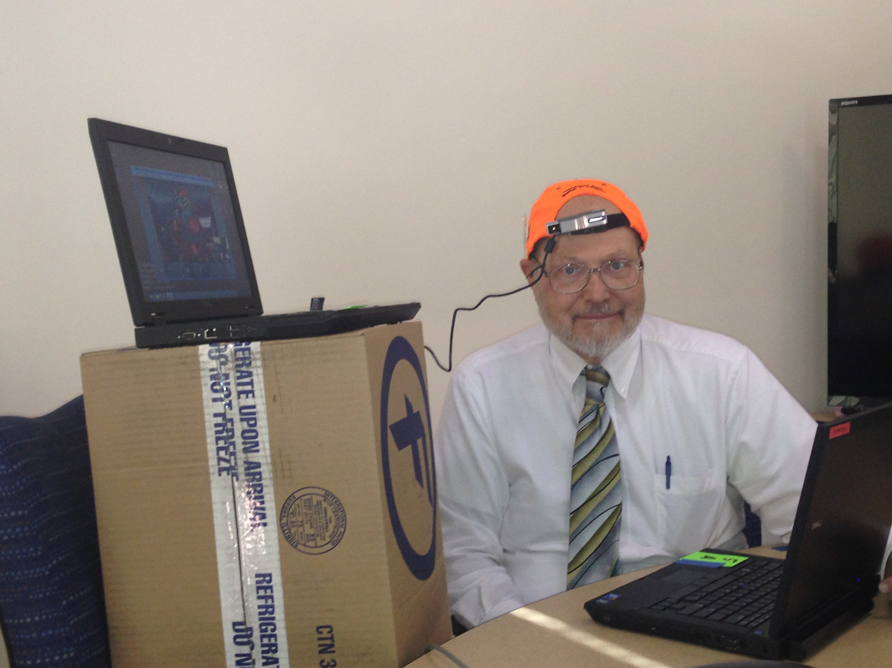
Per Ray (July 30, 2016): “I spend about 90 minutes to two hours a day in feeding the hungry blogs and twitter. I have not found a way to automate the editorial process. I do pre-post to help cover when I am on the road, but check for new materials each and every day of the year. For the past fifteen years, I scan digests, alerts, online journals, etc. to keep up with the latest technologies and trends in online and distance learning. I am grateful for the following I have cultivated, and I hope that my daily distillations help many others to keep up with this very active field.”

Slide 14
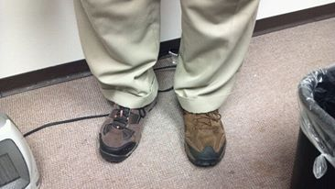
Per Ray: ”OH, do I have to admit that I am a Hoosier? ;-) Ok, South Bend, Indiana, December 8, 1949.”

Slide 15
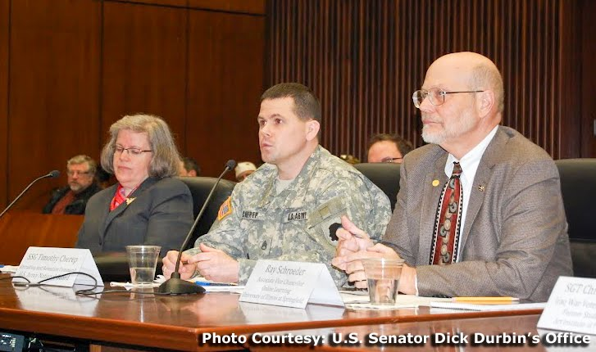
People call on Ray to do all sorts of things…
Like serve on congressional panels

Slide 16
Here are 15 more ways…

Slide 17
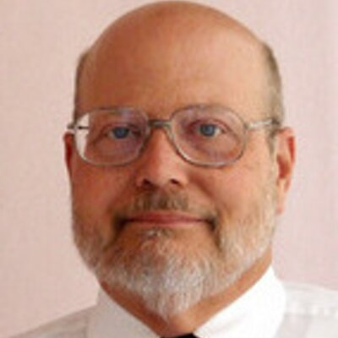
Question #1: Do you want to know best practices in leading an online initiative?
So…Who ya gonna call…?
Ray Schroeder!!!

Slide 18
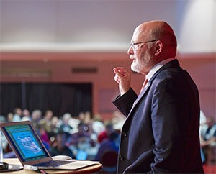
Question #2: Interested in how to start an online program at their universities?
So…Who ya gonna call…?
Ray Schroeder!!!

Slide 19
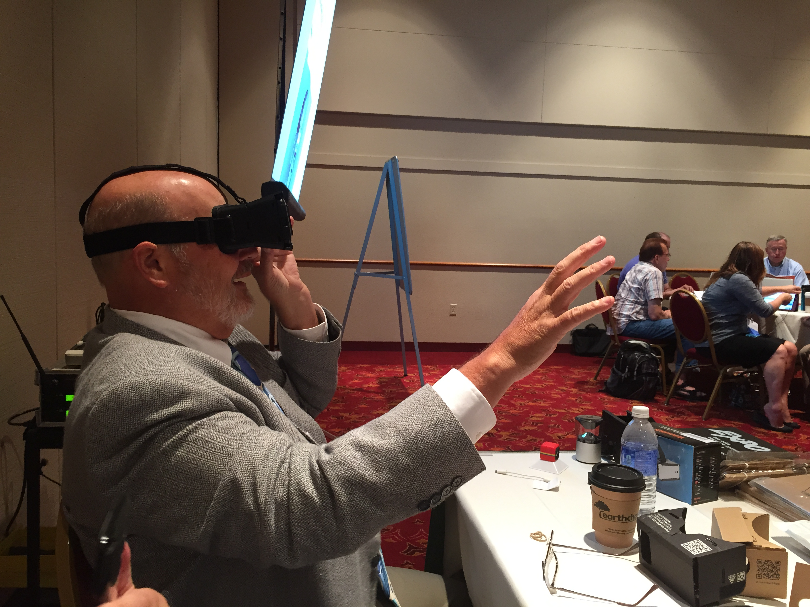
Question #3: Seeking innovative uses of technology in teaching?
So…Who ya gonna call…?
Ray Schroeder!!!

Slide 20
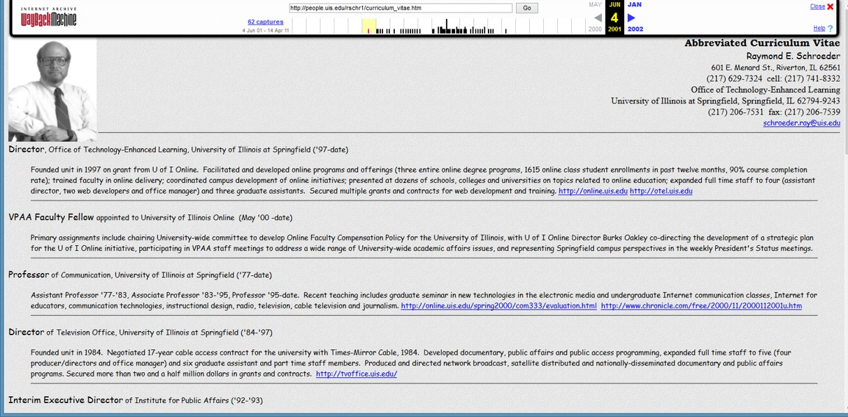
Question #4: Enrollment trends in online learning?
So…Who ya gonna call…?
Ray Schroeder!!!

Slide 21
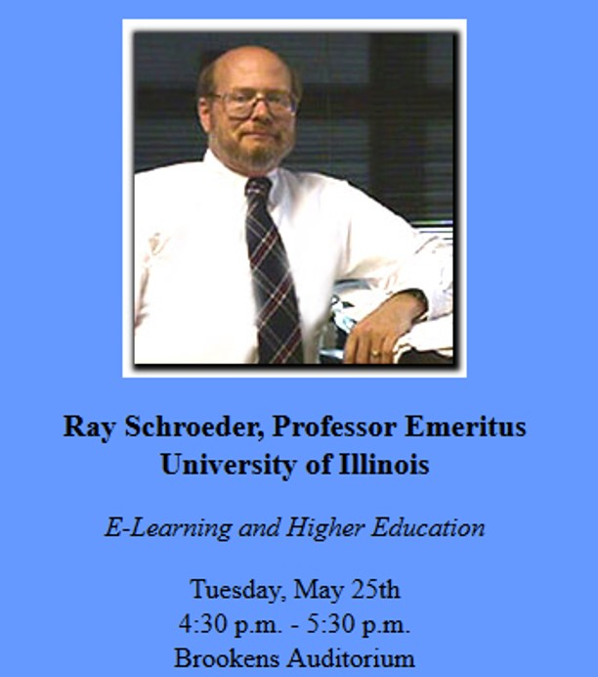
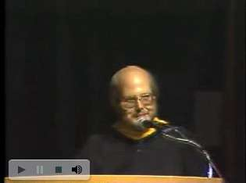
Question #5: Program development and appealing to a younger audience?
So…Who ya gonna call…?
Ray Schroeder!!!

Slide 22
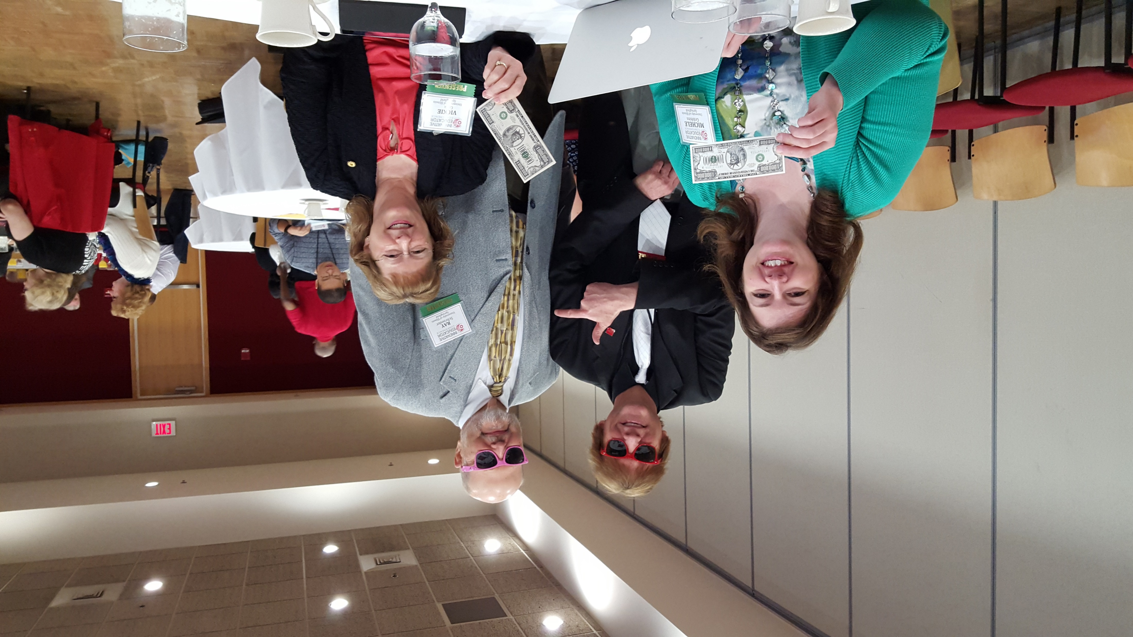
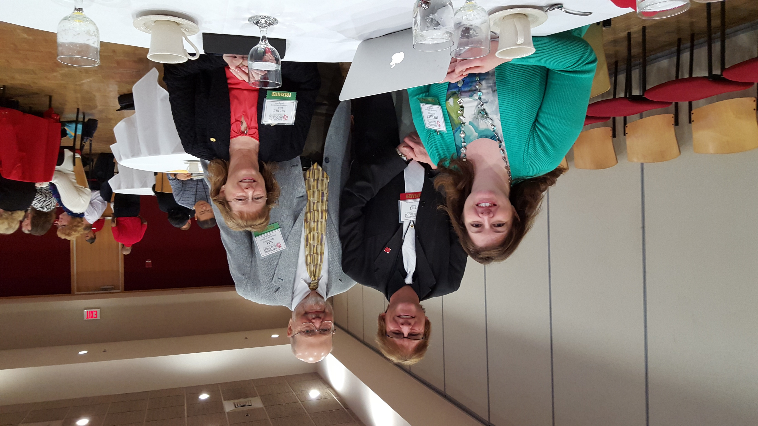
Question #6: Need help with budgets and calculating return on investment?
So…Who ya gonna call…?
Ray Schroeder!!!

Slide 23
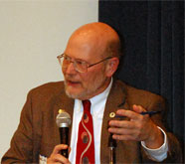
Question #7: Need a speaker on online learning, trends, and forecasts?
So…Who ya gonna call…?
Ray Schroeder!!!

Slide 24
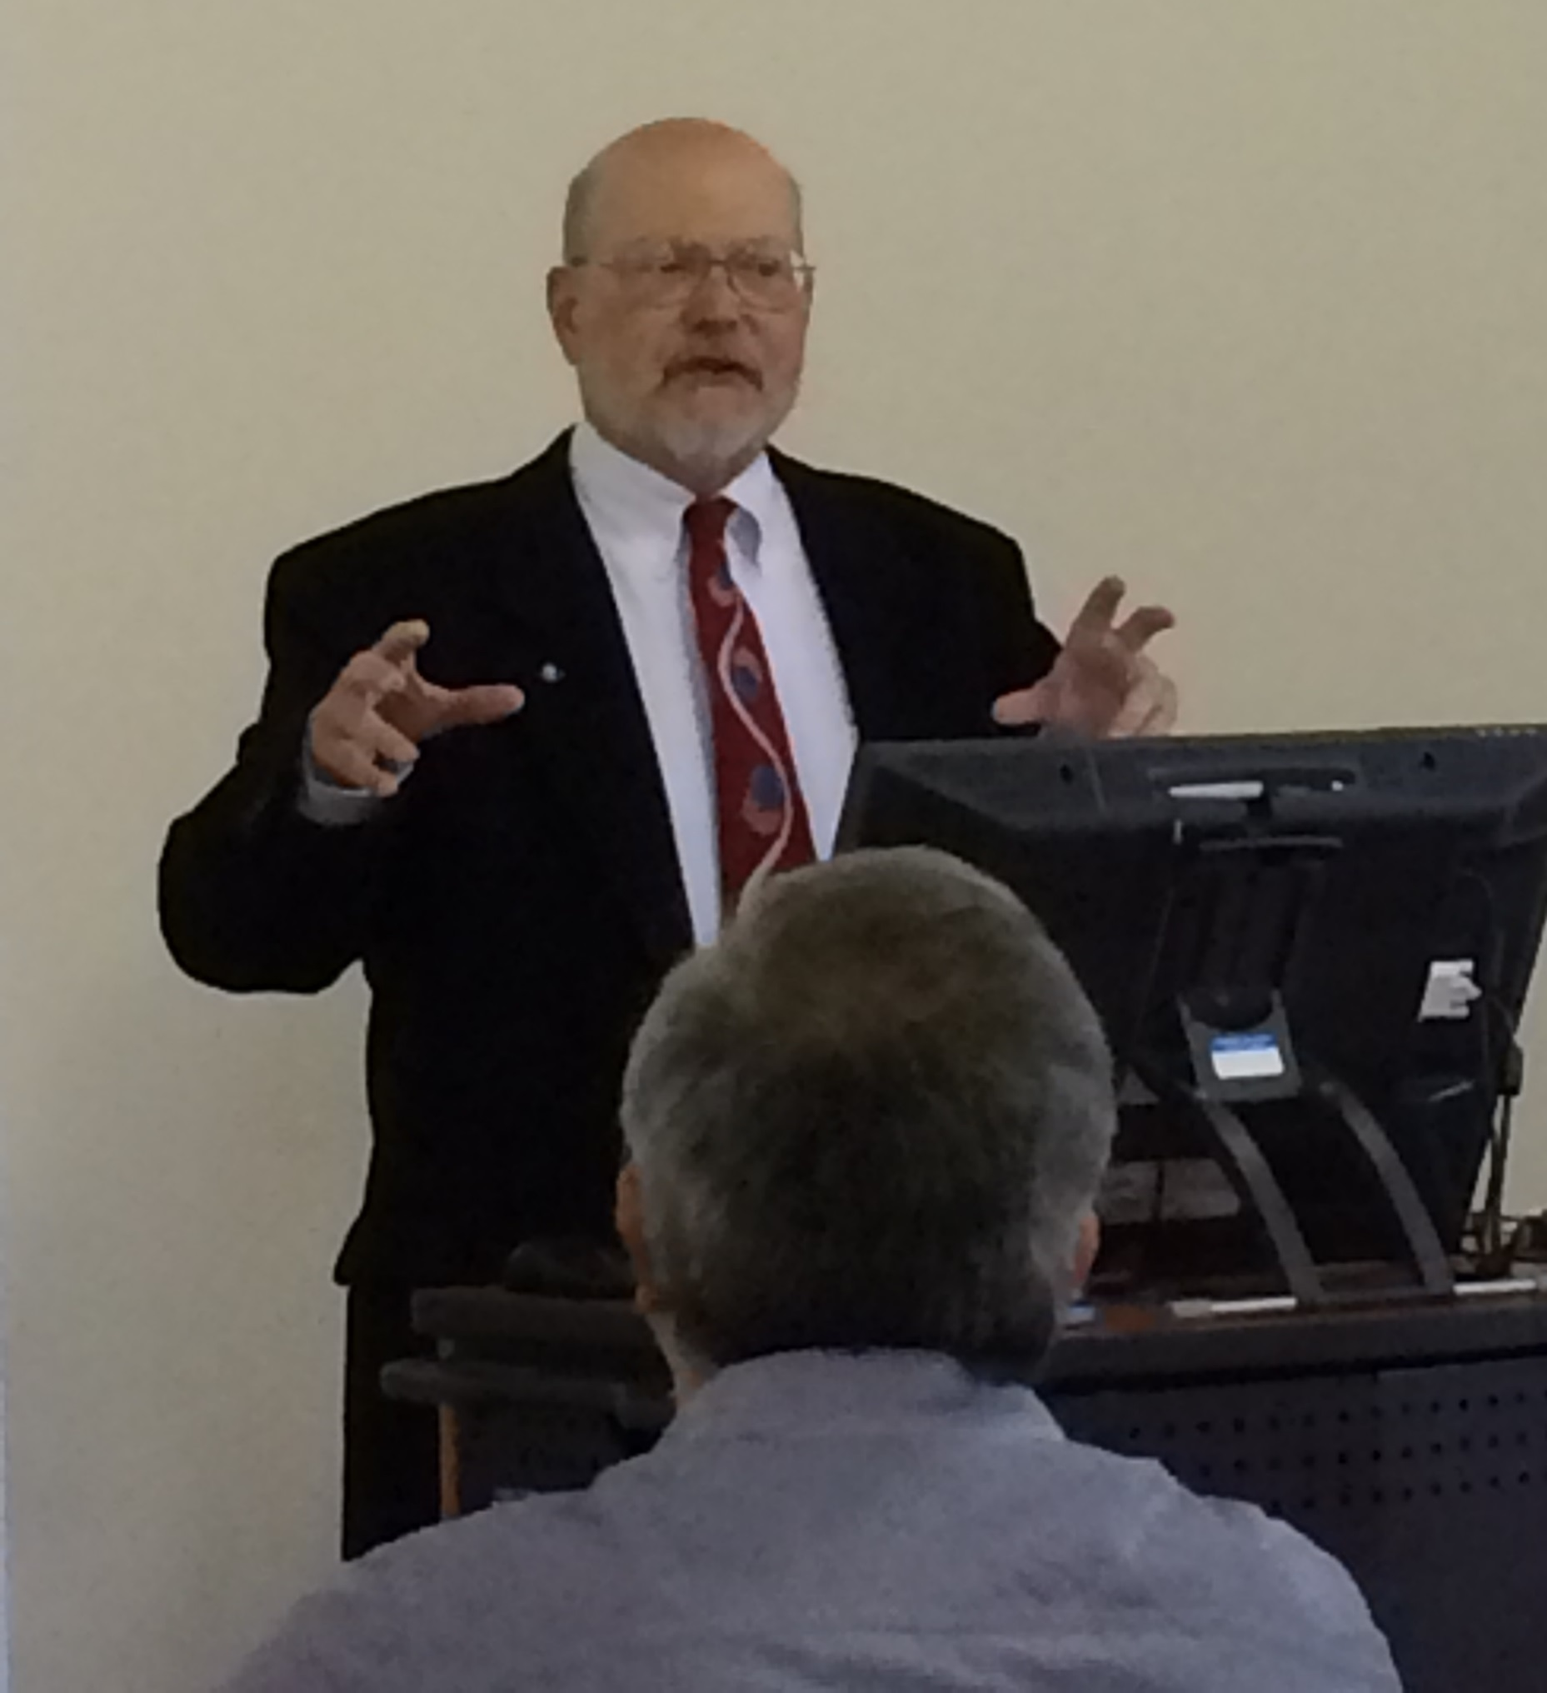
Question #8: Need someone to run a workshop?
So…Who ya gonna call…?
Ray Schroeder!!!

Slide 25
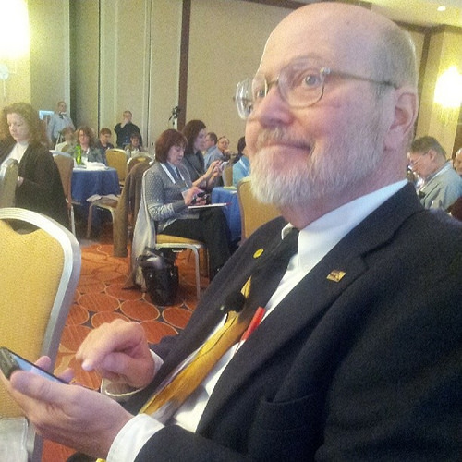
Question #9: What is the latest data on anything in ed tech?
So…Who ya gonna call…?
Ray Schroeder!!!

Slide 26
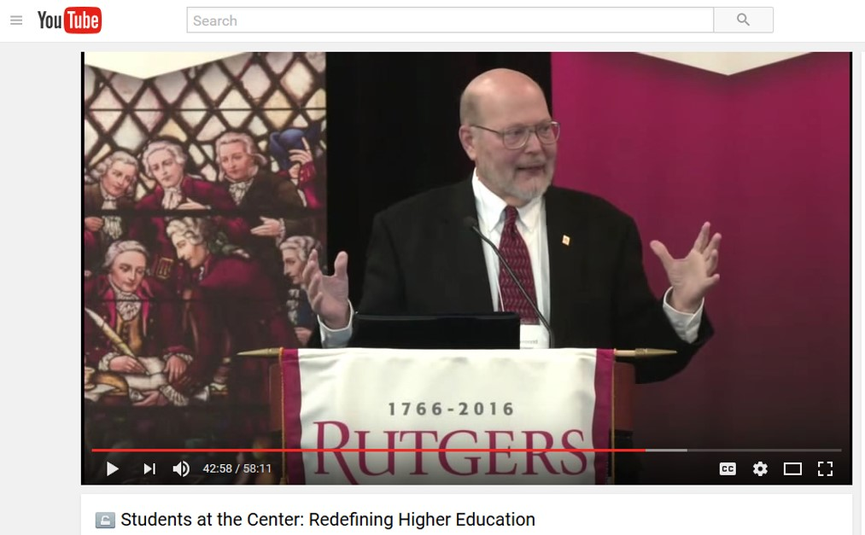
Question #10: What are online learning trends and leadership opportunities?
So…Who ya gonna call…?
Ray Schroeder!!!

Slide 27
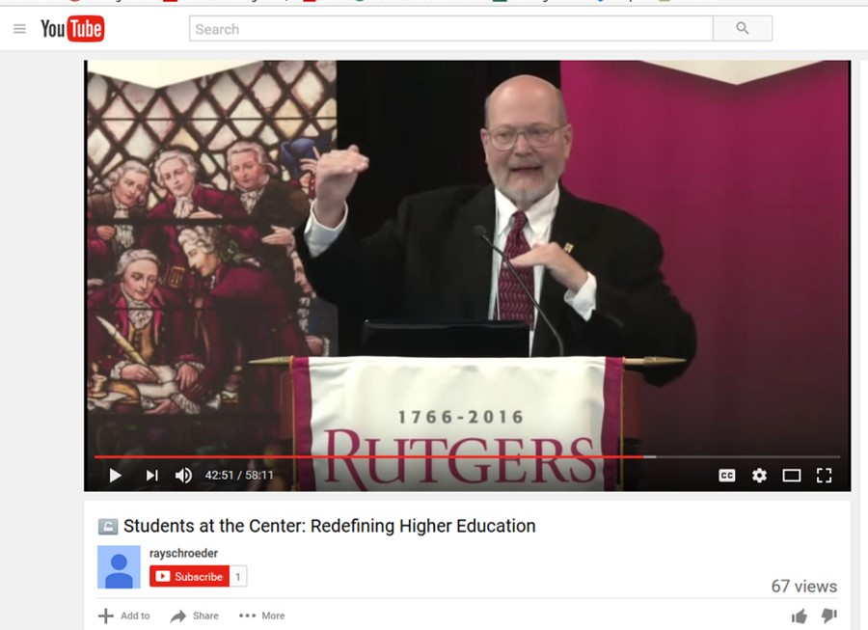
Question #11: What is happening in the Big 10 (14)?
So…Who ya gonna call…?
Ray Schroeder!!!

Slide 28
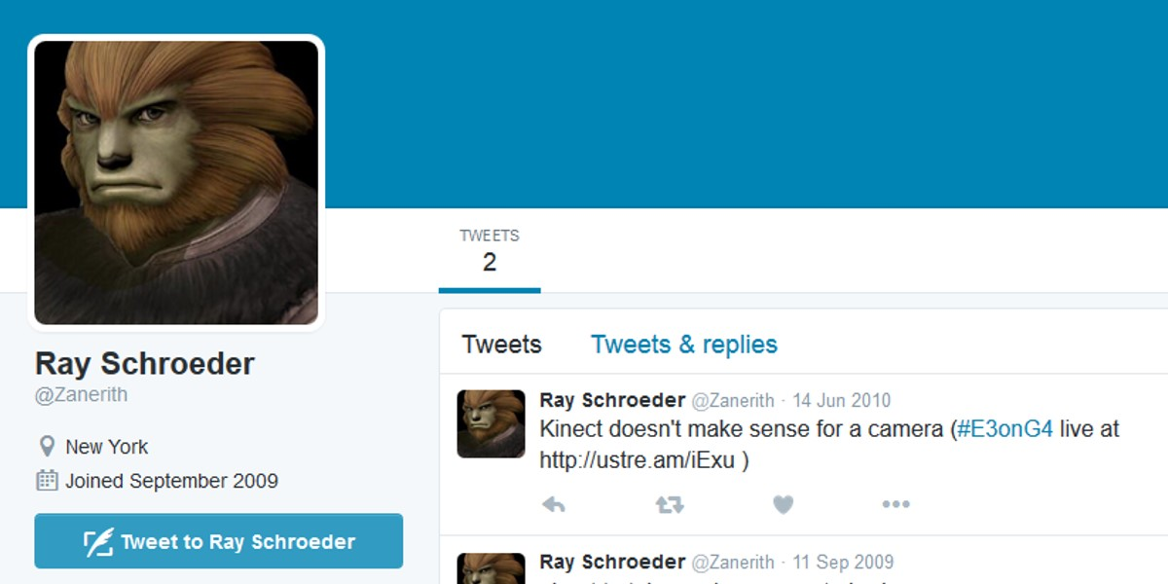
Question #12: How to effectively use social media?
So…Who ya gonna call…?
Ray Schroeder!!!

Slide 29
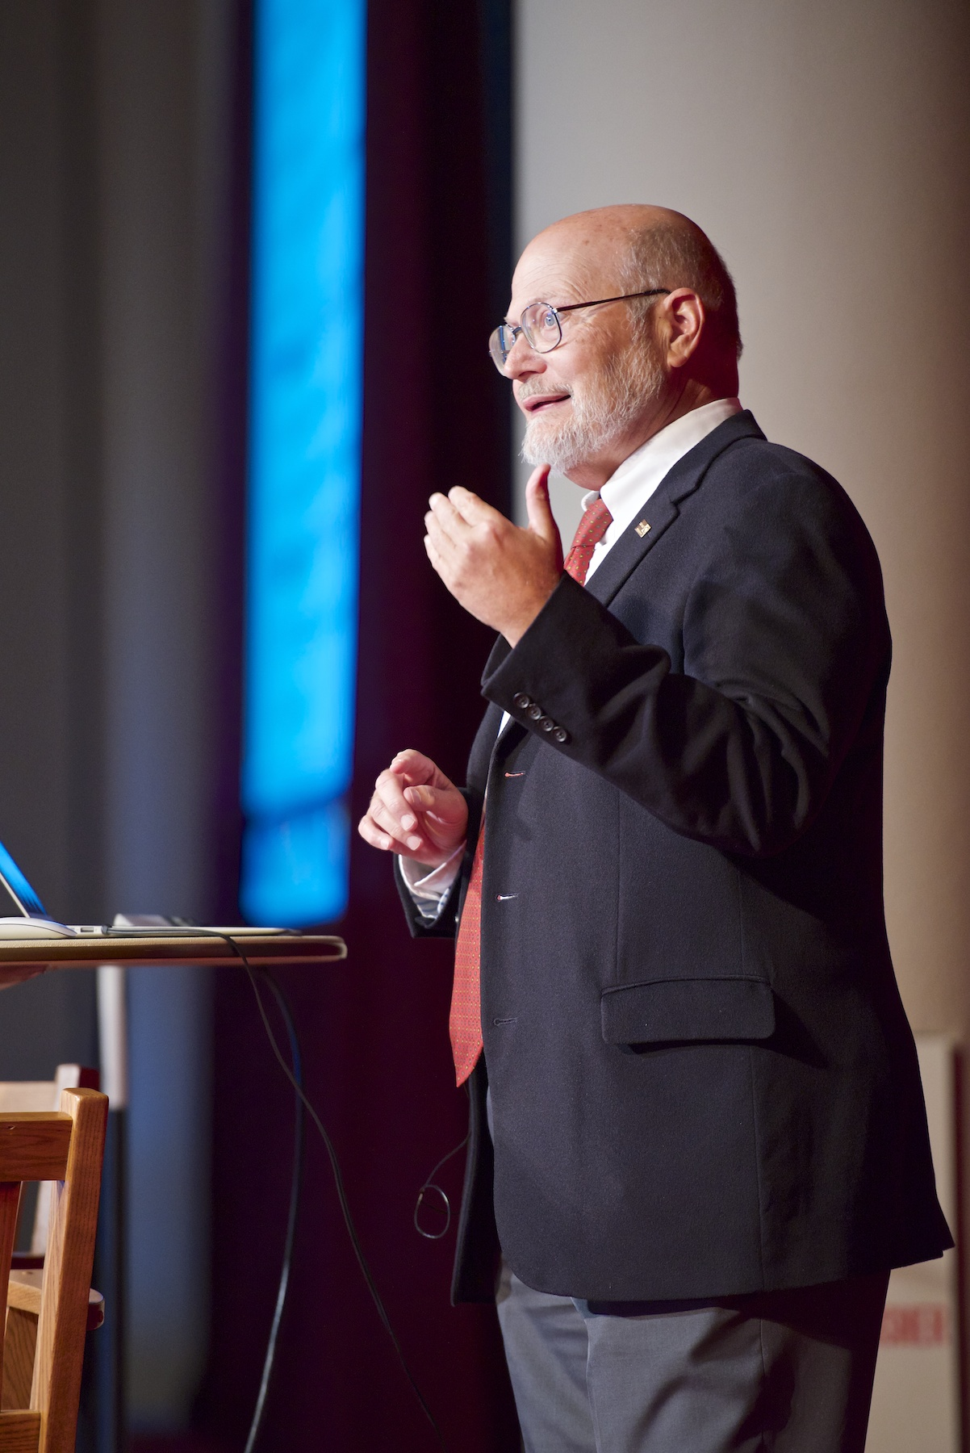
Question #13: Who should news reporters speak to about e-learning?
So…Who ya gonna call…?
Ray Schroeder!!!

Slide 30
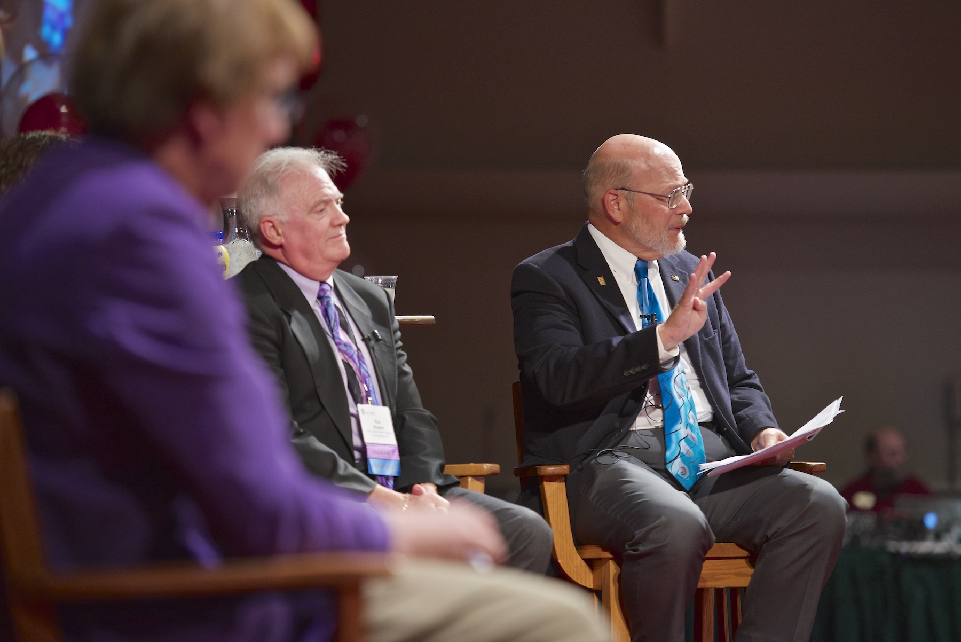
Question #14: Do you need someone for a conference panel?
So…Who ya gonna call…?
Ray Schroeder!!!

Slide 31
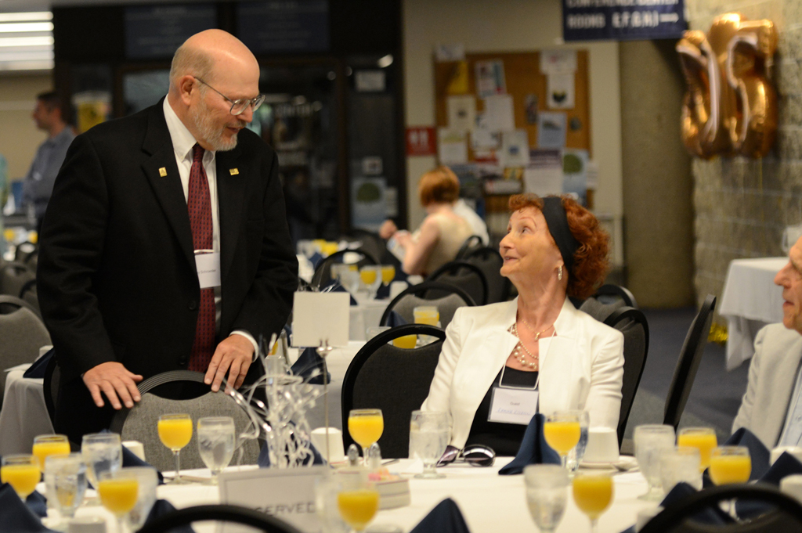
Question #15: And if you are out of servers for the conference lunch?
So…Who ya gonna call…?
Ray Schroeder!!!

Slide 32
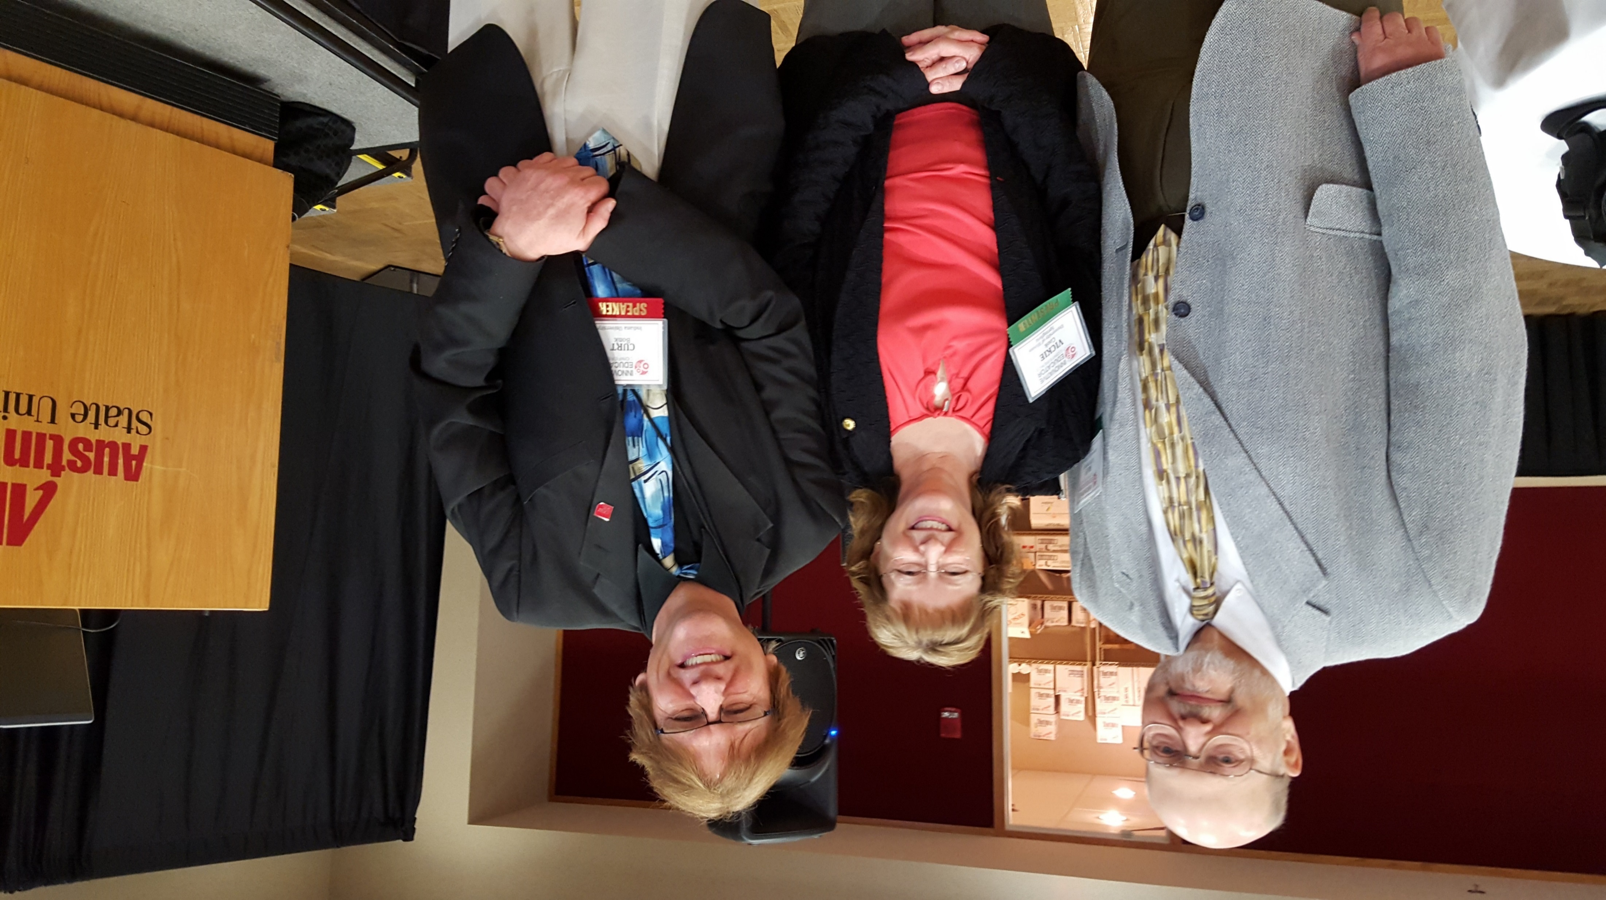
So…Who am I gonna call…?
Ray Schroeder!!!
Email: Schroeder.Ray@uis.edu Phone: 217-206-7531
https://sites.google.com/site/rayschroeder/

